Slide 1
PYTHON INSTALLATION

Slide 2
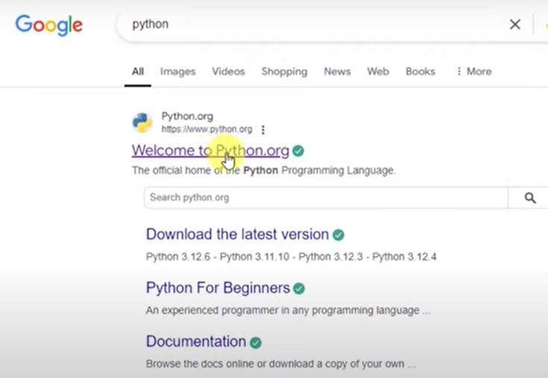
SEARCH “PYTHON” ON BROWSER > Python.org

Slide 3
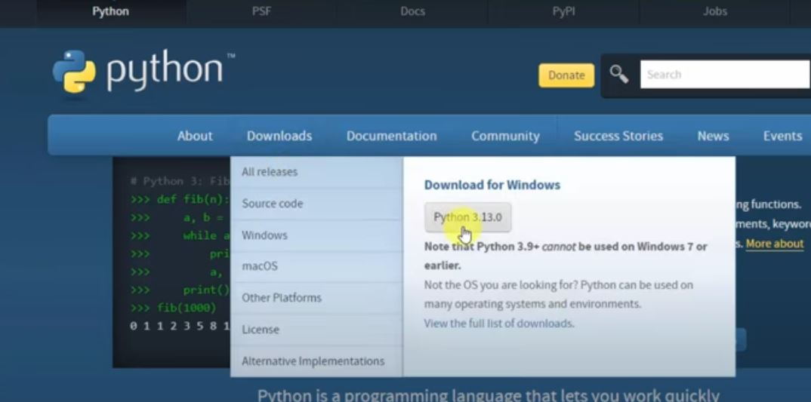
Hover on Downloads > Python 3.13.0(updated version)

Slide 4
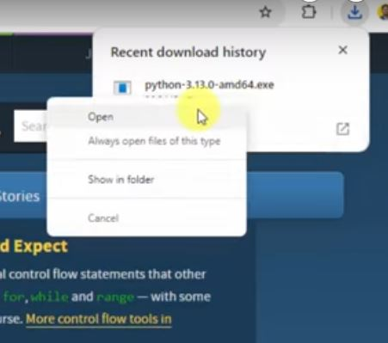
.exe File gets downloaded. Open it.

Slide 5
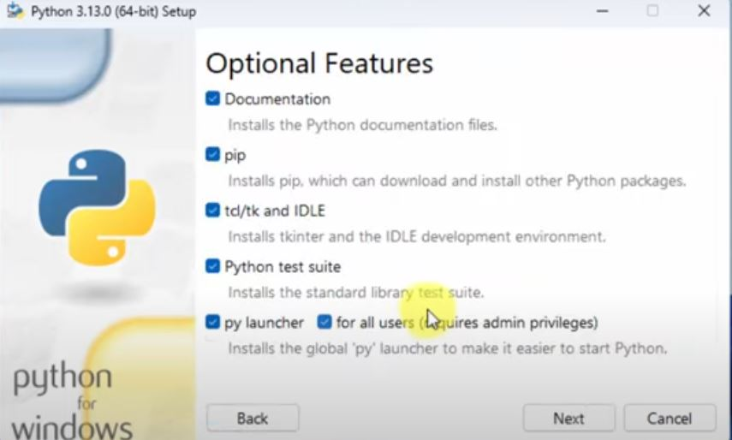
Setup(all checkboxes t be checked) > Next
IDLE stands for Integrated Development and Learning Environment. It is an integrated development environment (IDE) for Python, designed to be simple and suitable for beginners, especially in an educational context.

Slide 6
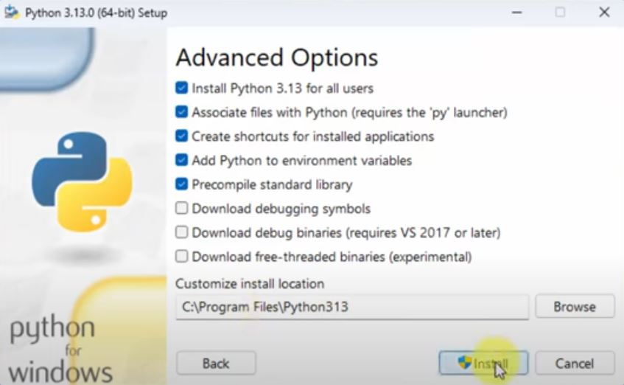
Checkboxes > Customize install location > Install

Slide 7
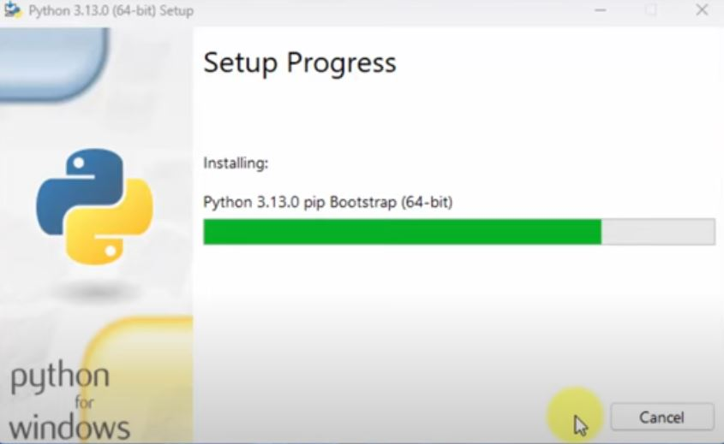
Setup Progress

Slide 8
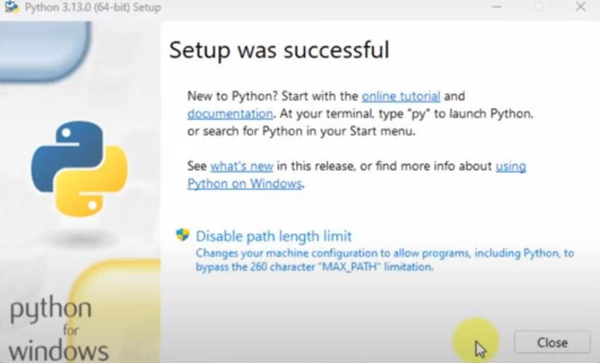
Setup gets successful

Slide 9
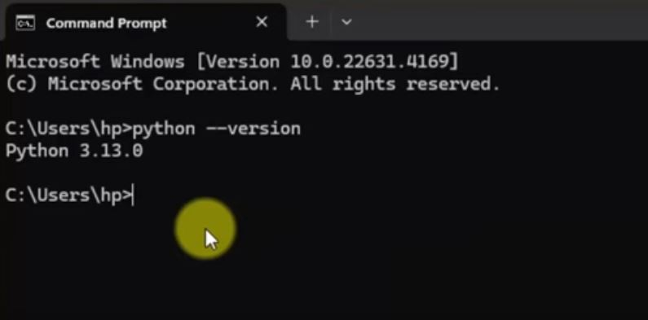
Check the installation in Command Prompt

Slide 10
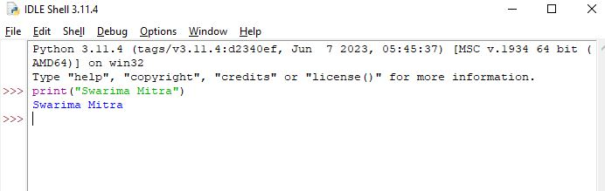
Check 1st Program on IDLE

Slide 11
ANACONDA INSTALLATION

Slide 12
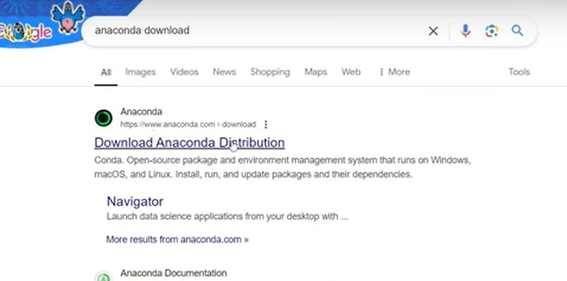
SEARCH “ANACONDA DOWNLOAD” ON BROWSER > www.anaconda.com

Slide 13
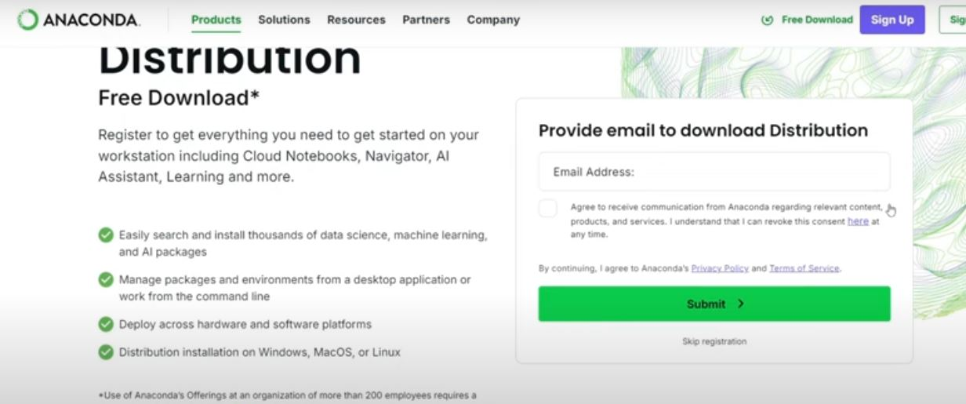
Either you can register using mail address or skip registration

Slide 14
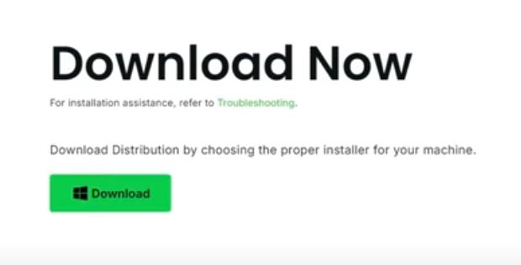
Click on Download > to start the downloading process

Slide 15
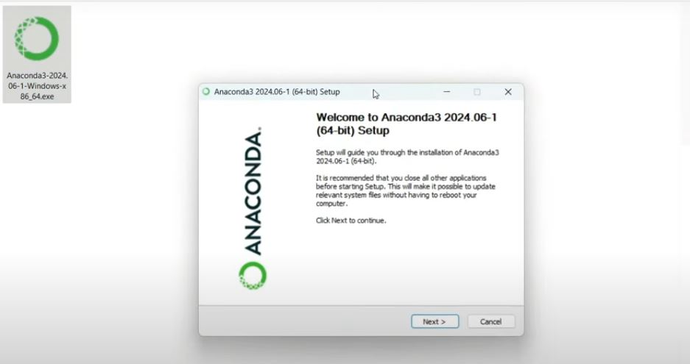
.exe file gets downloaded > Double click on Application > Start installing

Slide 16
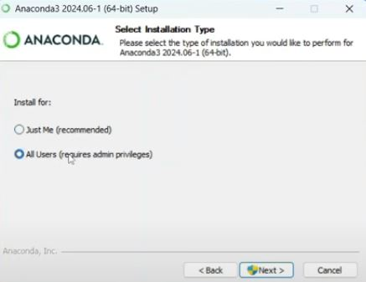
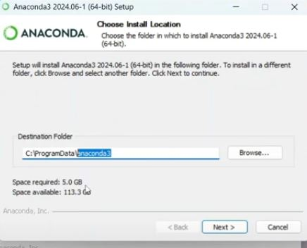
Check the radio button > Next > Set Folder Location

Slide 17
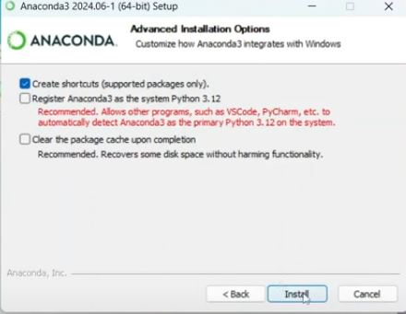
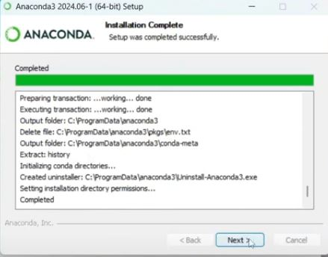
Tick checkboxes > Complete Installation > Next

Slide 18
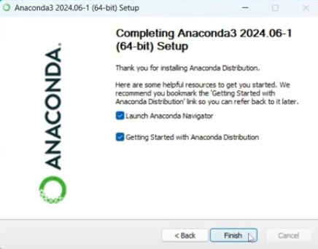
Finish & Reboot the system > Open Anaconda Application

Slide 19
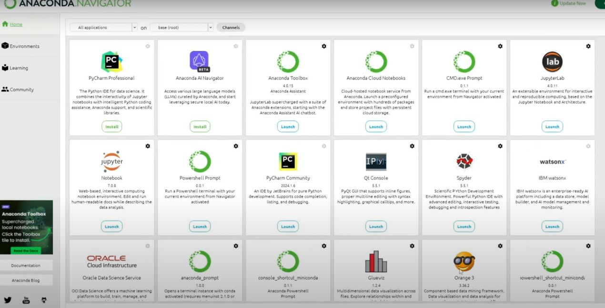
The Home View of Anaconda

Slide 20
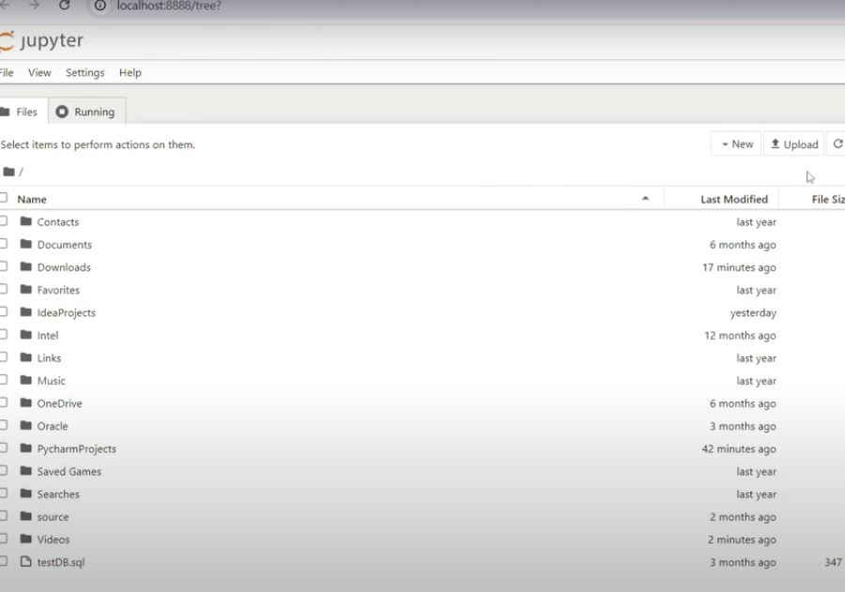
Launch Jupyter Notebook for Python Code

Slide 21
Tips to use Jupyter Notebook
Install using Anaconda for an all-in-one setup or run online using platforms like Google Colab.
Use Markdown cells for documentation to make your notebook well-structured and readable.
Save versions of your notebook regularly, especially when experimenting (Autosave)
Learn shortcuts like Shift + Enter to run cells and Ctrl + S to save.

Slide 22
THANK YOU

